Slide 1
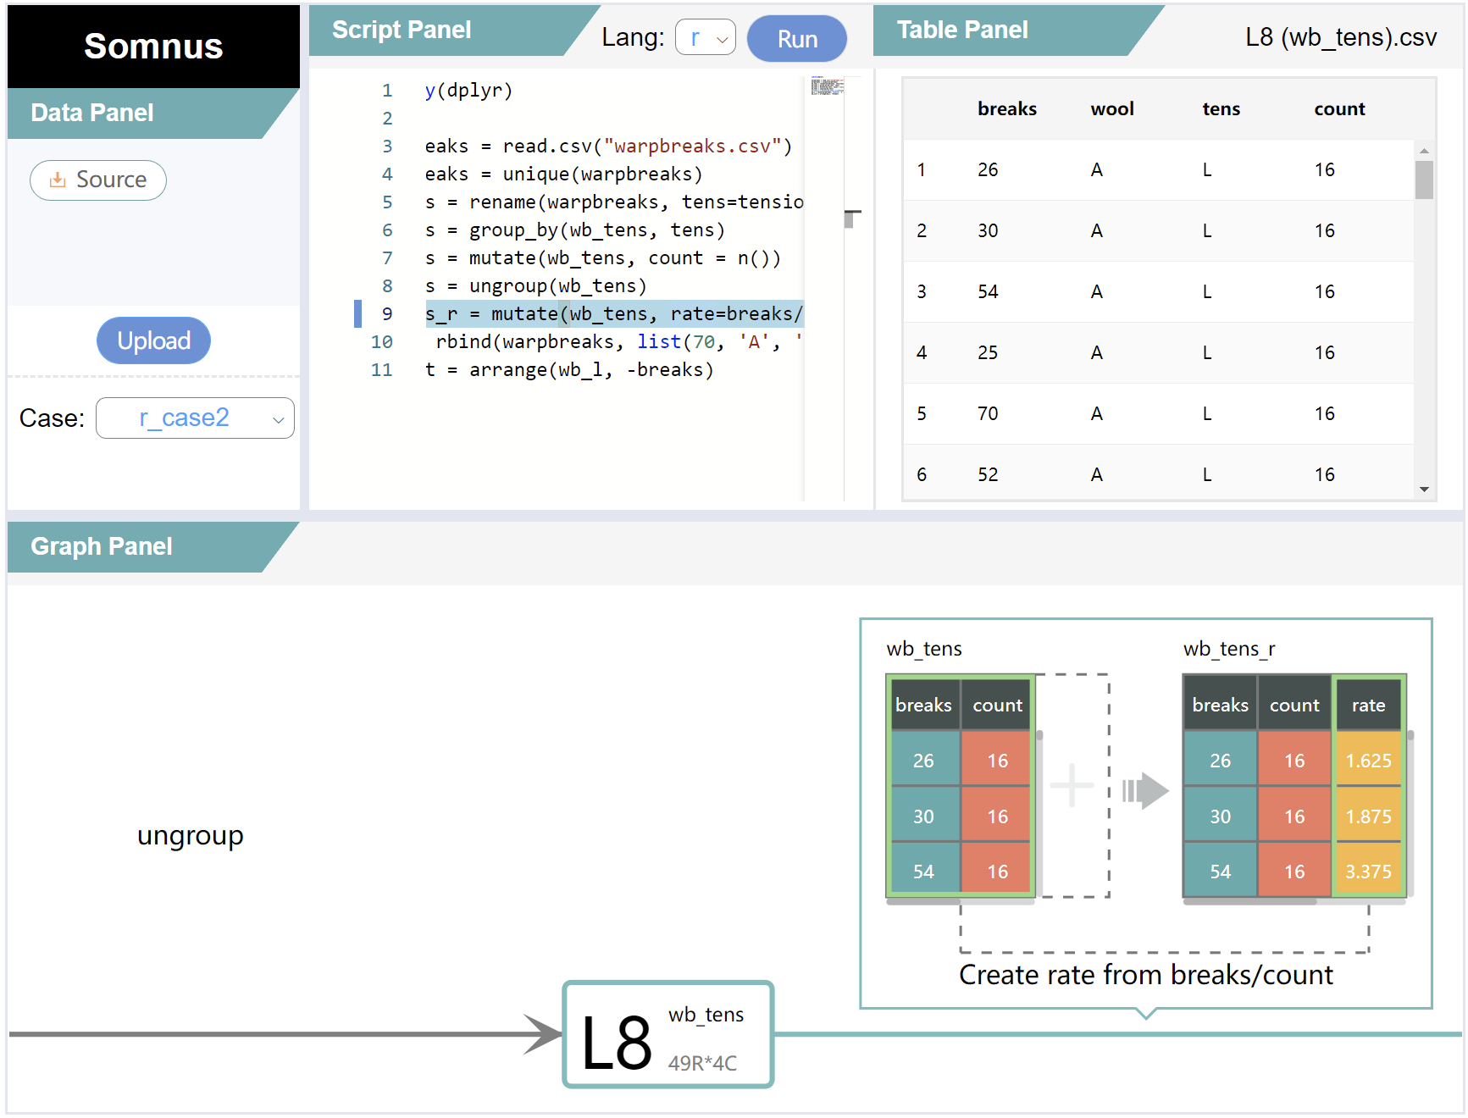



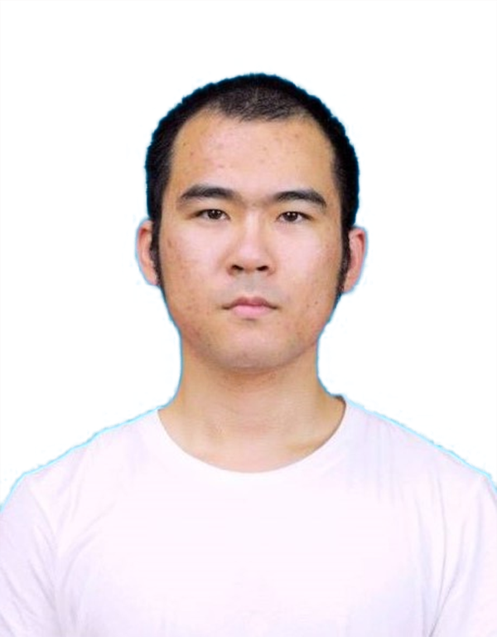





INTERACTIVE DATA GROUP
Visualizing the Scripts of Data Wrangling with SOMNUS
Kai Xiong^{1, 2}
Siwei Fu²
Guoming Ding^{1, 2}
Zhongsu Luo^{3, 2}
Rong Yu²
Wei Chen^{1, 2}
Hujun Bao^{1, 2}
Yingcai Wu^{1, 2}
¹ State Key Lab of CAD&CG, Zhejiang University, Hangzhou, China
² Zhejiang Lab, Hangzhou, China
³ Zhejiang University of Technology, Hangzhou, China
Notes:
Hello everyone, I am Kai from Zhejiang University.
Today I will introduce a latest paper from our group: Visualizing the Scripts of Data Wrangling with SOMNUS.

Slide 2




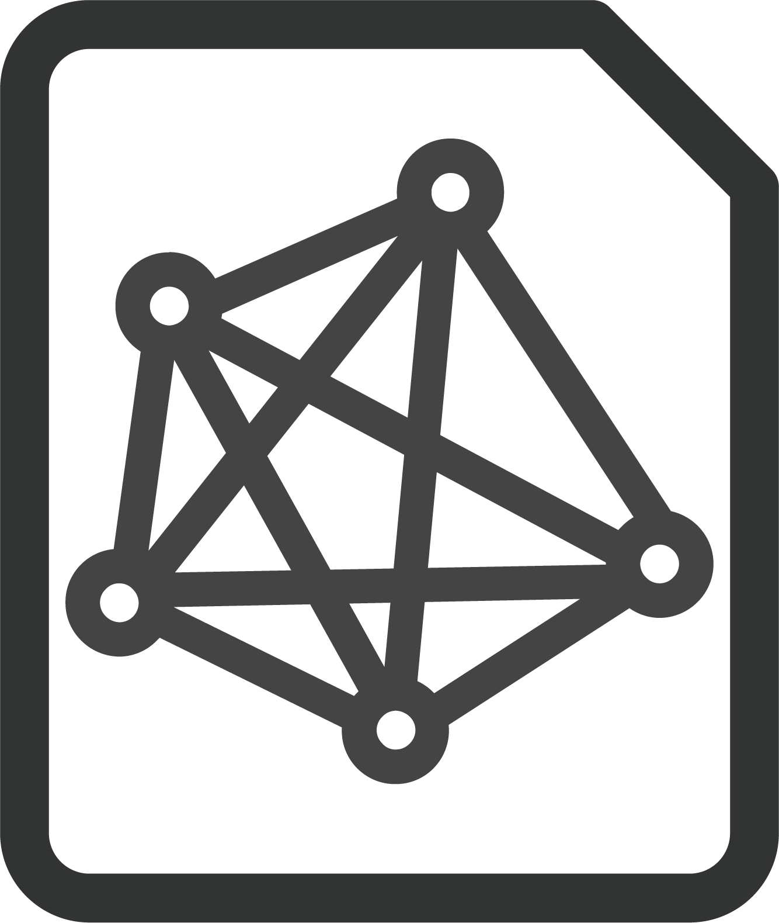

Data Wrangling
transform, reformat, integrate
Notes:
Data wrangling is an arduous process of <click> transforming, reformatting, and integrating data to make it more palatable for miscellaneous <click> downstream purposes, such as visualization and analysis

Slide 3
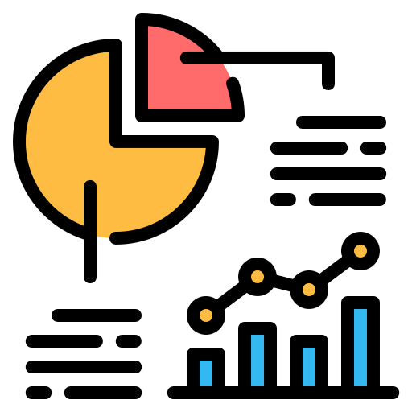


Data Wrangling
transform, reformat, integrate
Visualization
Analysis
Notes:
Data wrangling is an arduous process of <click> transforming, reformatting, and integrating data to make it more palatable for miscellaneous <click> downstream purposes, such as visualization and analysis

Slide 4

Data Transformation
Notes:
Data wrangling often involves <click> a number of data transformations such as filtering rows, merging columns, and sorting.

Slide 5
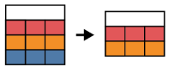
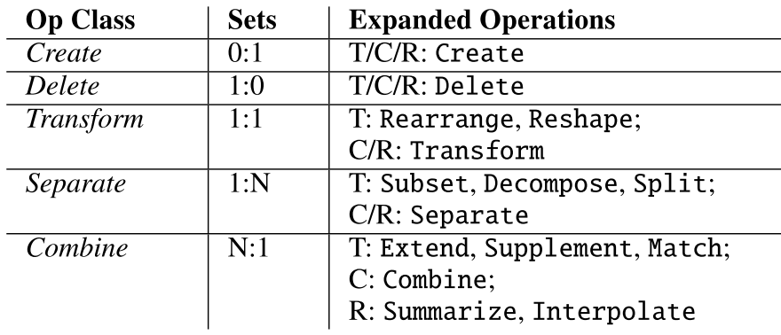
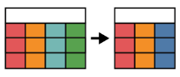
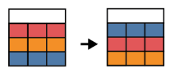

Data Transformation
filter rows
Kasica et al. 2021.
merge columns
sort
a multi-table framework for data wrangling
S. Kasica, C. Berret, and T. Munzner. Table Scraps: An actionable framework for multi-table data wrangling from an artifact study of computational journalism. IEEE TVCG, 2021.
Notes:
Data wrangling often involves <click> a number of data transformations such as filtering rows, merging columns, and sorting.
<click> Kasica et al. structured a multi-table framework for data wrangling, including 21 transformation operations.

Slide 6


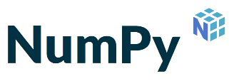
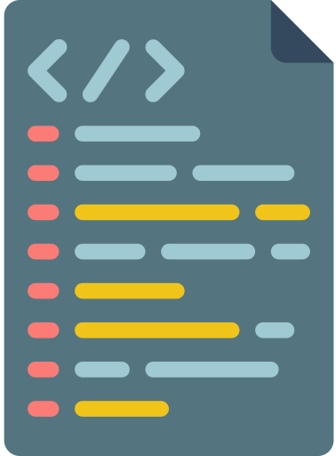


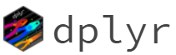

Understanding the Semantics of Scripts
How was the data changed?
Notes:
Nowadays, numerous <click> scripting languages with their data manipulation libraries have been commonly used for data wrangling.
At the same time, <click> data workers usually seek to understand the semantics of scripts <click> in various scenarios.

Slide 7



Understanding the Semantics of Scripts
How was the data changed?
Validating
Reusing
Notes:
such as validating the process of data transformation to ensure accuracy <click> and learning the idea of data wrangling for reusing.

Slide 8


Understanding the Semantics of Scripts
How was the data changed?
Programming skills
Time-consuming
Notes:
However, understanding scripts requires <click> advanced programming skills <click> and the process is time-consuming.

Slide 9
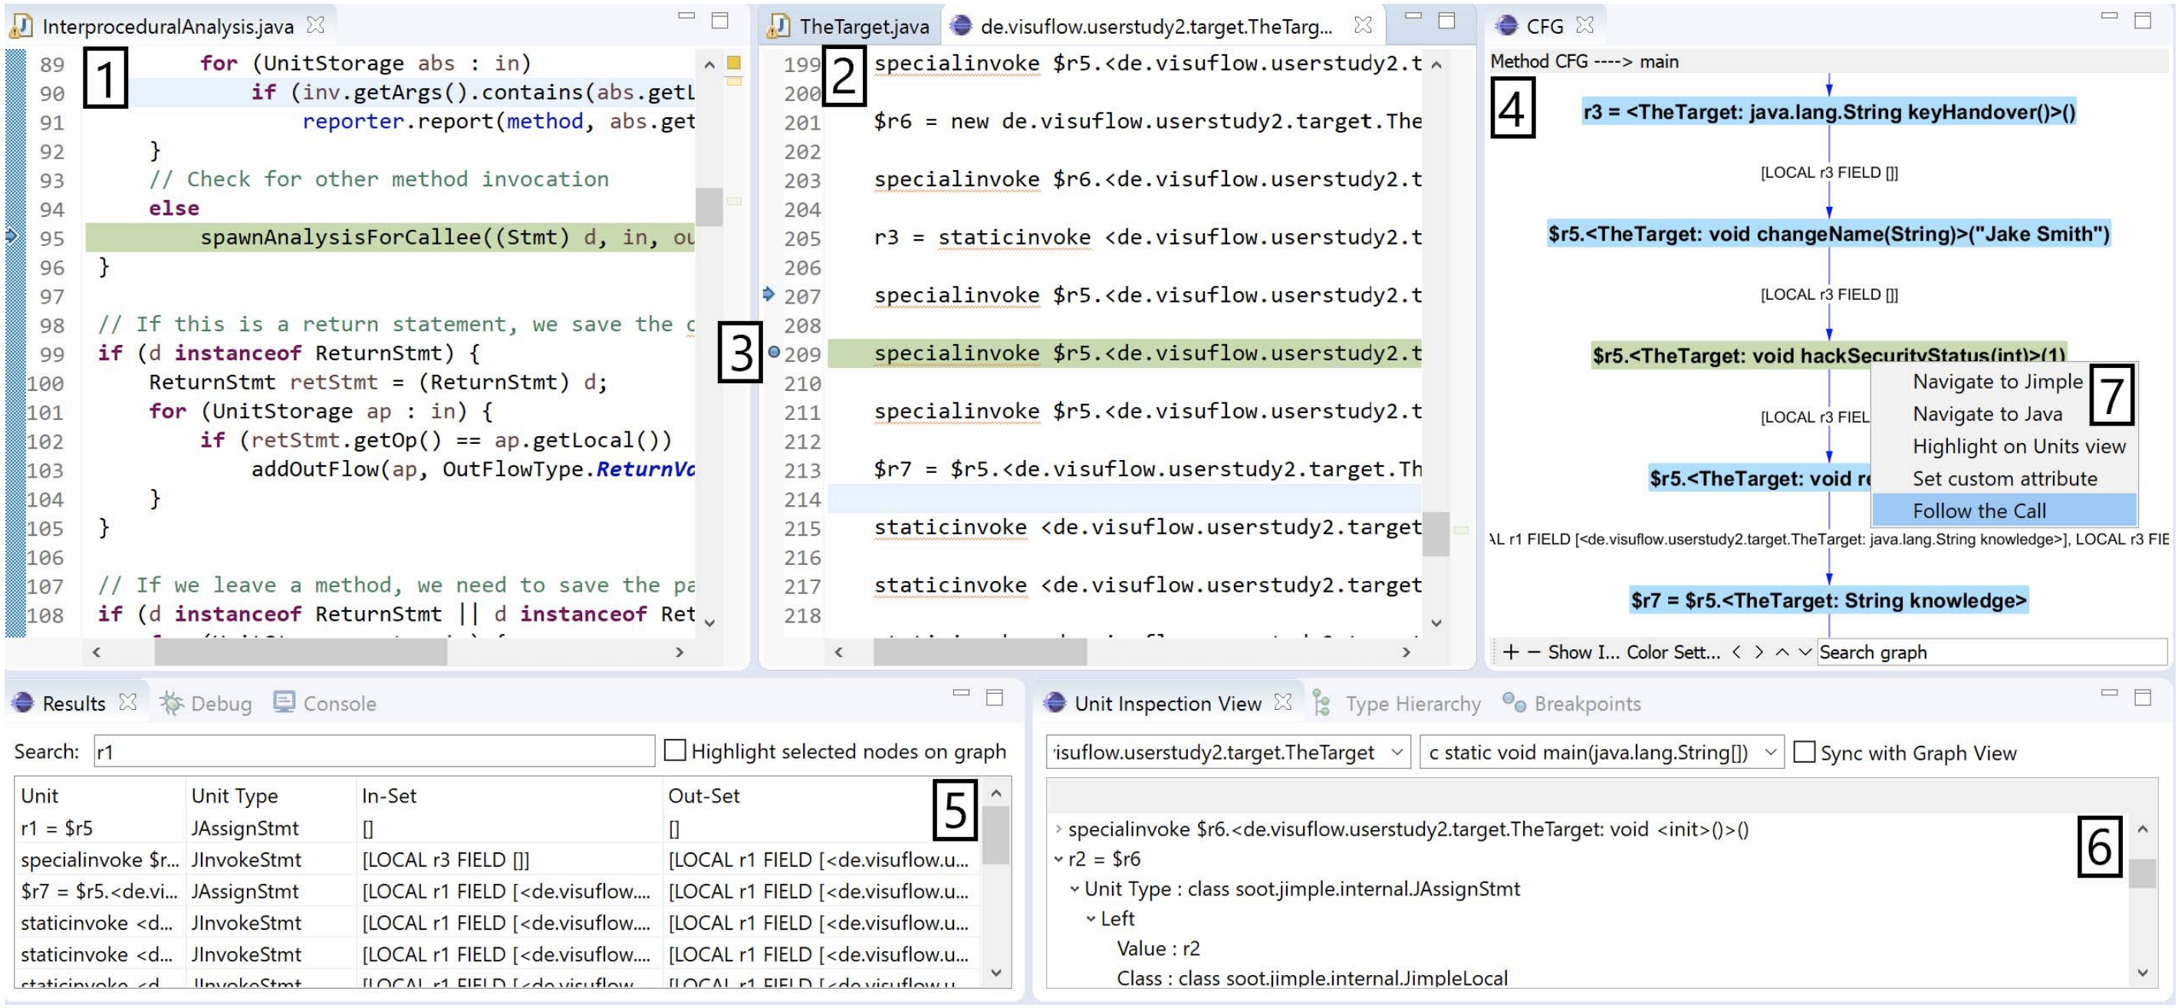
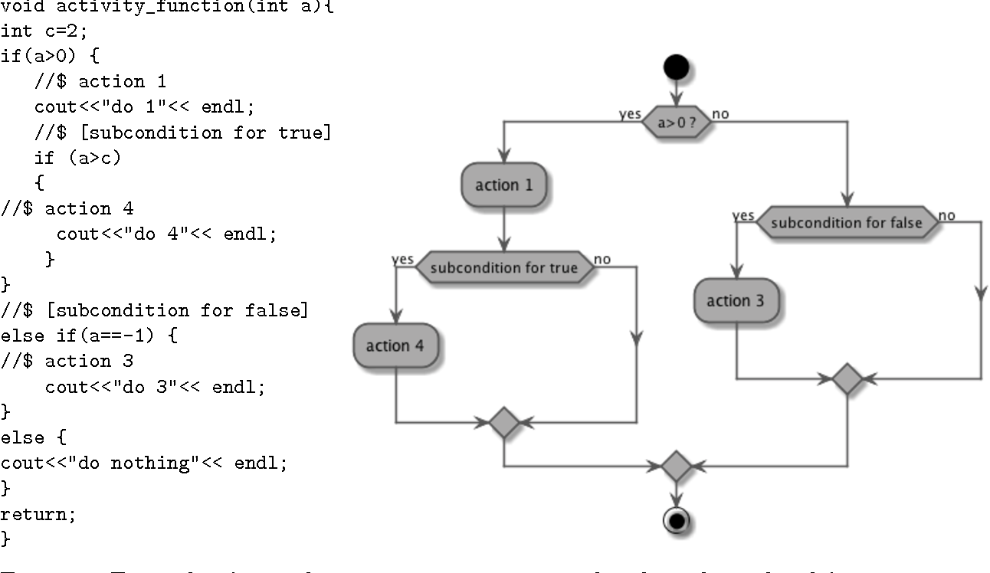
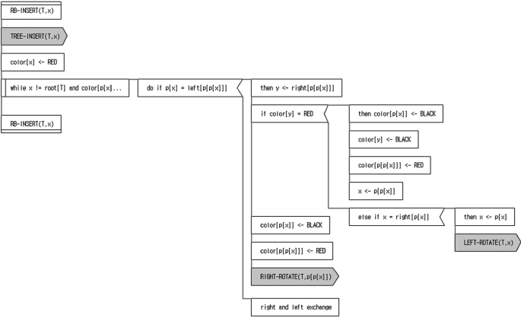
Program Visualization
Nguyen et al. 2018
Kosower et al. 2014
Cheon et al. 2019
VisuFlow
Flowgen
VizMe
Not in the context of data transformation
Notes:
A number of program visualization techniques have been proposed for debugging and communication.
But none of them <click> are proposed in the context of data transformation which aims to reveal the evolution of tabular data.

Slide 10
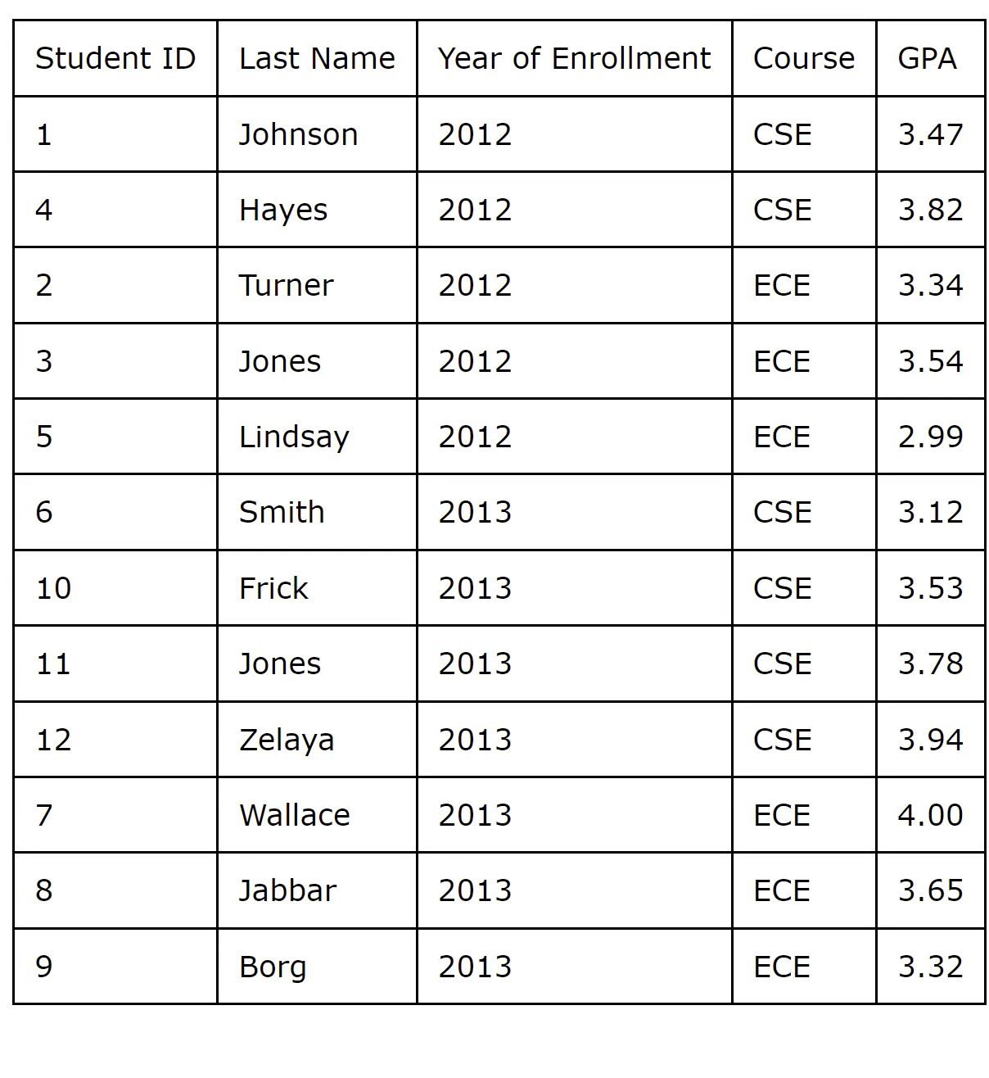
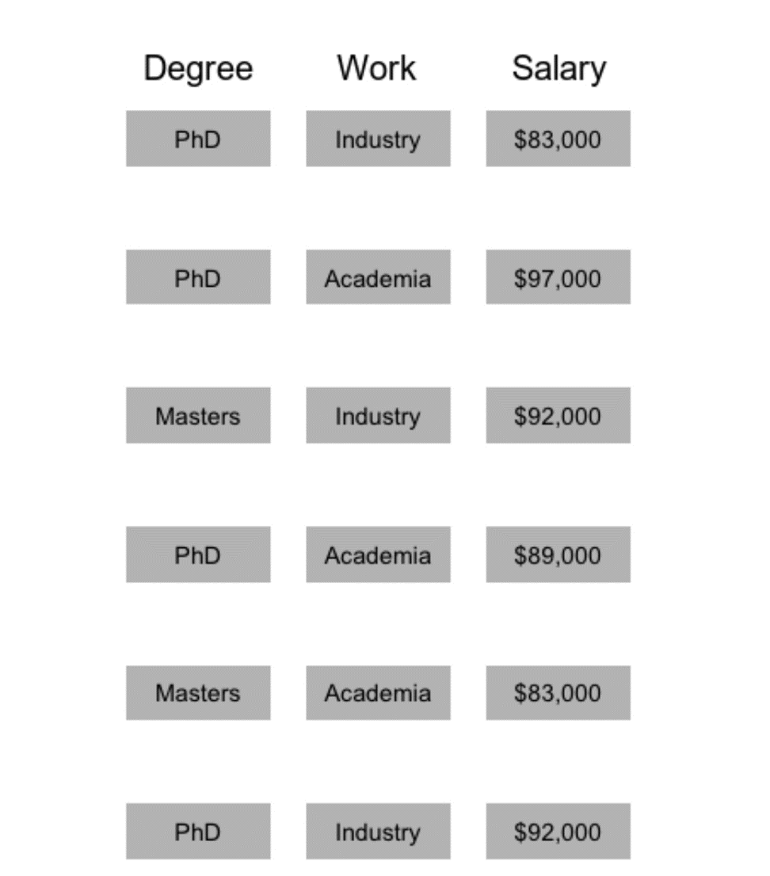
Data Provenance
Khan et al. 2017
Pu et al. 2021
Data Tweening
Datamations
hard to explore and only for a single table
Notes:
Data provenance records the history of changes during analysis.
Several tools leverage animations to visualize the provenance of tabular data.
Animation is useful for communication. However, <click> it is hard to explore and control.
Besides, those tools focus on presenting the provenance of a single table.

Slide 11
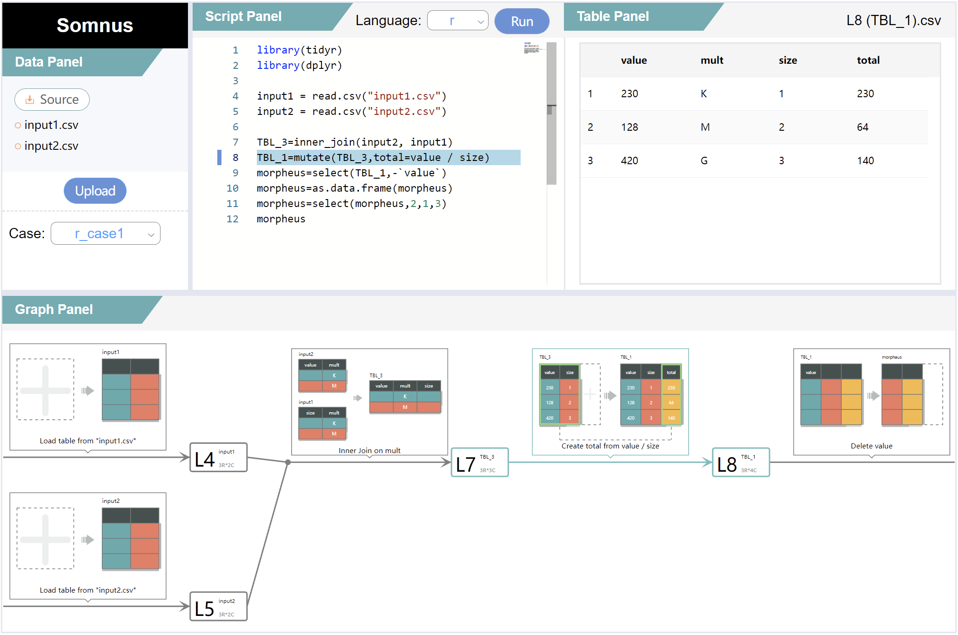
Notes:
In this work, we design and implement a pipeline, SOMNUS, to visualize the semantics of code pieces in the context of data transformation.

Slide 12

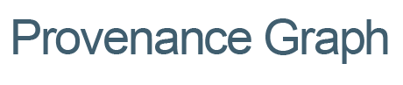
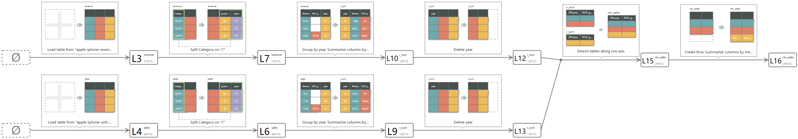



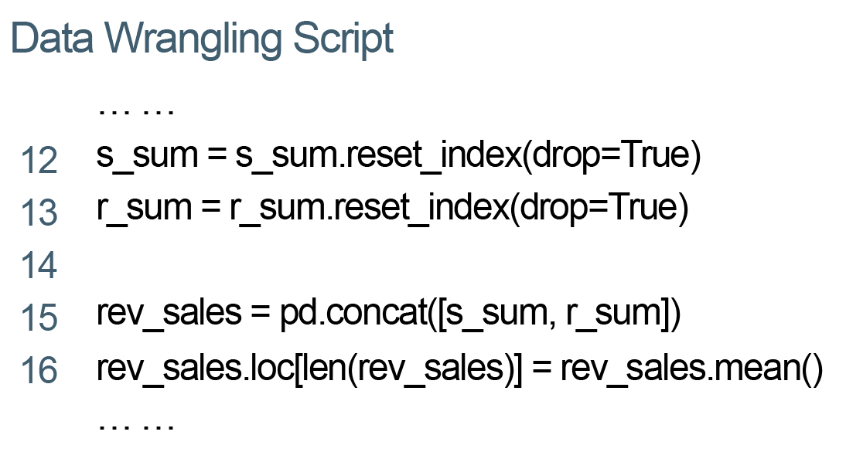
SOMNUS Overview
Input
Output
Notes:
SOMNUS accepts a data wrangling script with its source tables as input and results in a glyph-based provenance graph where nodes represent tables and edges denote data transformations.

Slide 13
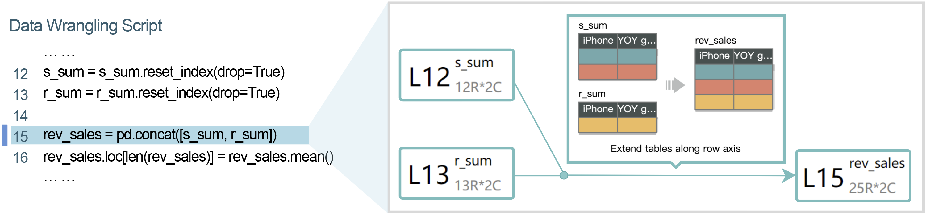
SOMNUS Overview
Input
Output
Notes:
SOMNUS accepts a data wrangling script with its source tables as input and results in a glyph-based provenance graph where nodes represent tables and edges denote data transformations.

Slide 14

Design Requirement
R1: Present the Semantics
R2: Link with Data
R3: Depict Necessary Information
R4: Keep Encoding Consistent
R5: Reveal Table Provenance
R6: Dig into Details
R7: Independent of Programming Languages
Notes:
In order to help data workers understand and communicate a data wrangling script, we conducted several rounds of interviews with data analysts to iteratively extract design requirements.

Slide 15

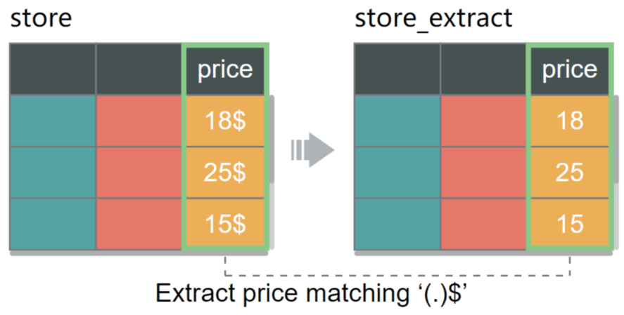
Design of Glyphs
Kasica et al. 2021
depict
Design space of glyphs
Data transformations
Parameter Space
Visual Channels
which information shall be encoded
which visual channels can be mapped
Notes:
Guided by the requirements, we first explore the design space of glyphs for depicting individual data transformations.
The design space consists of two primary dimensions, namely, <click> the type of parameters and potential visual channels.

Slide 16


Design of Glyphs
Parameter Space
Visual Channels
84 are from
160 functions
23 are from
6 parameters
53 are from
Notes:
After examining 160 functions used for data transformation, we categorize <click> six key parameters that should be mapped to visual channels.

Slide 17
Design of Glyphs
Parameter Space
Visual Channels
5
1
4
Transformation Parameters
Contextual Columns/Rows
Function Name
col1 | col2 | price
a | 1 | 18$
b | 1 | 25$
c | 2 | 15$
store_extract = extract(store, price, “price”, “(.)$”) # transform price
2
Data Tables
3
Explicit Columns/Rows
store
2
1
2
col1 | col2 | price
a | 1 | 18
b | 1 | 25
c | 2 | 15
col1 | col2 | col3
A | 1 | m
B | 2 | t
A | 1 | m
tbl4 = unique(tbl3) # delete duplicate rows
6
Implicit Columns/Rows
store_extract
tbl3
Notes:
Take the line of code as an example, “extract” <click> is a function name that reflects the transformation operation it targets.
“store” and “store_extract” <click> are the input and output tables of the function, respectively.
These columns “price” <click> are explicitly mentioned in the function.
The parameter <click> shows how to transform the column “price”.
And the “col1” and “col2” <click> are contextual columns that are not involved in the data transformation.
Besides, we also consider <click> implicit columns/rows which are involved in a data transformation but not explicitly mentioned in the function.

Slide 18
Design of Glyphs
Parameter Space
Visual Channels
store_extract = extract(store, price, “price”, “(.)$”) # transform price
Notes:
After that, we design glyphs to visualize transformations.
We use <click> the table metaphor as the fundamental structure <click> of our glyphs.

Slide 19



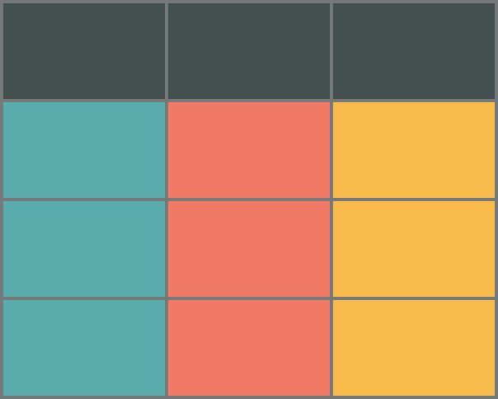



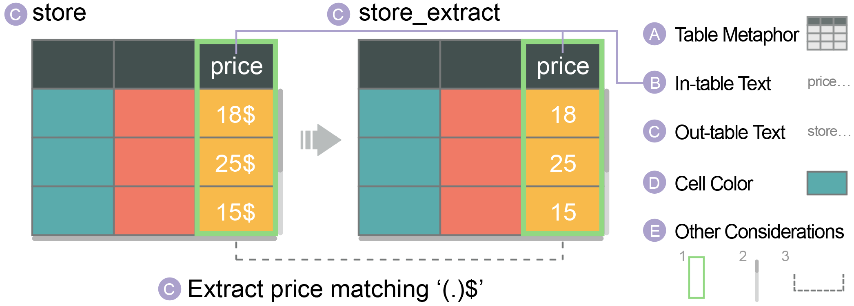
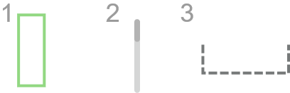
Design of Glyphs
Parameter Space
Visual Channels
store_extract = extract(store, price, “price”, “(.)$”) # transform price
A
Table Metaphor
B
In-table Text
price…
C
Out-table Text
store…
D
Cell Color
E
Other Considerations
Please refer to our paper for the detailed design rationale.
Notes:
Each glyph contains three main parts, namely, <click> an input table, <click> an output table, <click> and an arrow indicating the transformation.
We explore possible visual channels for our glyphs to encode the six parameters, including <click> in-table text, <click> out-table text, <click> cell color, <click> and some other considerations.

Slide 20
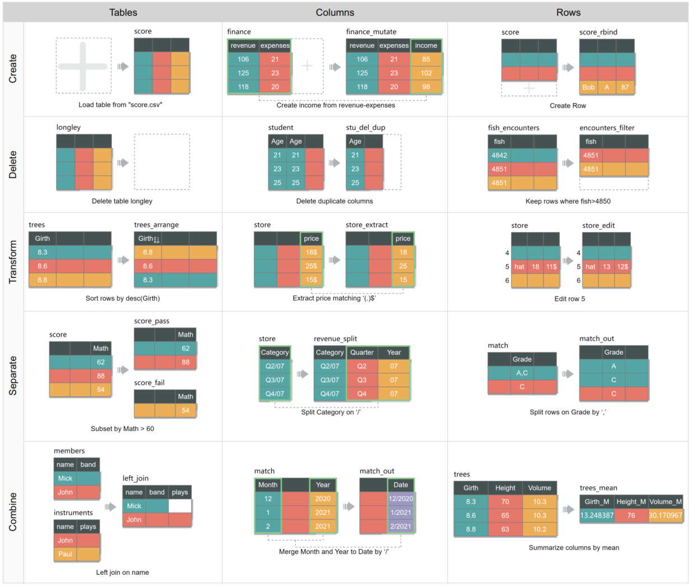
Design of Glyphs
Notes:
Based on the design space, we derive a glyph collection to depict different types of data transformations.
Here are 15 examples that comprehensively cover the transformation space proposed by kasica et al.

Slide 21

SOMNUS Architecture
Program
Adaptor
Visualization Generator
Script
Provenance Graph
Transformation
Specification
Program Execution
Data Provenance Construction
Code Parser
Data Tables
Glyph Presentation
Transformation Inference
Notes:
After that, we develop SOMNUS to visualize the semantics of a data wrangling script.
The architecture of SOMNUS consists of two major modules: <click> the Program Adaptor <click> and the Visualization Generator.

Slide 22
SOMNUS Architecture
Program
Adaptor
Visualization Generator
Script
Provenance Graph
Transformation
Specification
Program Execution
Data Provenance Construction
Code Parser
Data Tables
Glyph Presentation
Transformation Inference
Notes:
After that, we develop SOMNUS to visualize the semantics of a data wrangling script.
The architecture of SOMNUS consists of two major modules: <click> the Program Adaptor <click> and the Visualization Generator.

Slide 23
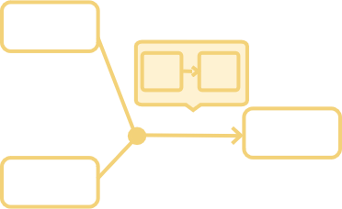
SOMNUS Architecture
Program
Adaptor
Visualization Generator
Script
Provenance Graph
Transformation
Specification
Program Execution
Data Provenance Construction
Code Parser
Data Tables
Glyph Presentation
Transformation Inference
Notes:
After that, we develop SOMNUS to visualize the semantics of a data wrangling script.
The architecture of SOMNUS consists of two major modules: <click> the Program Adaptor <click> and the Visualization Generator.

Slide 24

SOMNUS
Program Adaptor
Visualization Generator
Program Execution
Line
Input Table
Output Table
1
Code Parser
2
Transformation Inference
…
Notes:
Program Adaptor aims to generate a series of transformation specifications. It contains three steps.
<click>First, Program Execution uses a corresponding language interpreter to execute the script.
This step can obtain input and output tables for each function, which helps to construct the provenance of tables.

Slide 25
SOMNUS
Program Adaptor
Visualization Generator
Program Execution
Function Name
Function Parameters
unite
tbl2 = unite(tbl1, "new_col", col1, col2, sep=":") # merge columns
Code Parser
tbl2
tbl1
"new_col", col1, col2, sep=":"
Output Table
Input Table
Transformation Inference
Notes:
Then, Code Parser will parse each line of wrangling code into three parts, namely, the variable names of the input and output tables, the function name, and the function parameters.

Slide 26
SOMNUS
Program Adaptor
Visualization Generator
Program Execution
Input Table:
tbl1
Transformation Type
Code Parser
Output Table:
tbl2
Function Name:
unite
Transformation Inference
Function Parameters:
"new_col", col1, col2, sep=":"
Notes:
Last, we craft rules to infer the transformation type of the line of code based on the results of the above two steps.

Slide 27
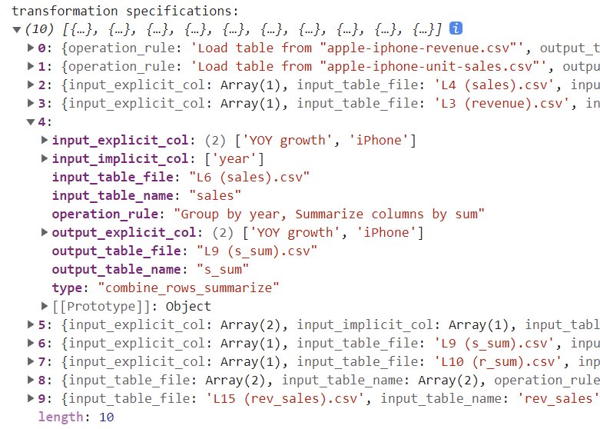
SOMNUS
Program Adaptor
Visualization Generator
Program Execution
Code Parser
Transformation Inference
Notes:
After parsing all lines of wrangling code and deriving their data transformations, Program Adaptor generates a specification for each transformation.

Slide 28
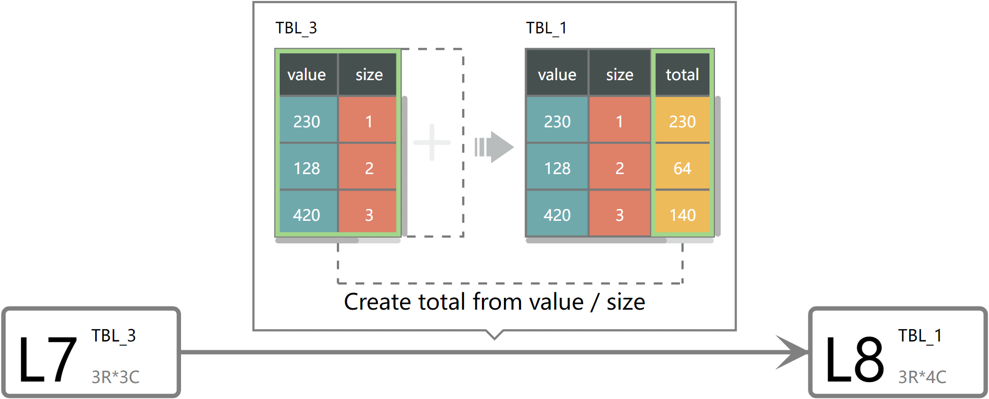
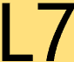
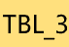
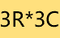
SOMNUS
Program Adaptor
Visualization Generator
Data Provenance Construction
Data Transformation
Glyph Presentation
Data Tables
Notes:
Then, the Visualization Generator will construct a data provenance graph by utilizing these specifications.
<click>The nodes of the graph are data tables, and <click> the edges are data transformations.
We depict useful table information in each node, including <click> where the table is created, <click> the table name, <click> and the size of the table.

Slide 29
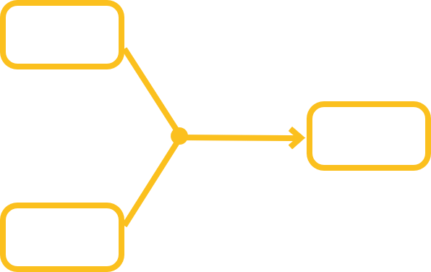
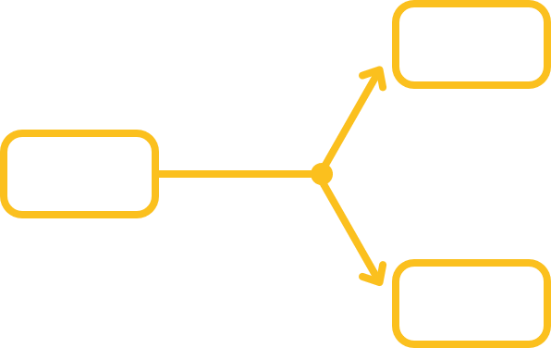

SOMNUS
Program Adaptor
Visualization Generator
Data Provenance Construction
Convergence edges:
(many-to-one)
Divergence edges:
(one-to-many)
Glyph Presentation
Directed edges:
(one-to-one, create/delete tables)
Notes:
According to the number of input and output tables, we categorize edges into three types, namely, <click>convergence edges for many-to-one table transformations, <click>divergence edges for one-to-many table transformations, and <click>directed edges for others, like one-to-one table transformations.

Slide 30
SOMNUS
Program Adaptor
Visualization Generator
Data Provenance Construction
Glyph Presentation
Notes:
Finally, we depict glyphs <click> aside from each edge to present the detailed semantics of data transformations, thus <click> gaining the final provenance graph.

Slide 31
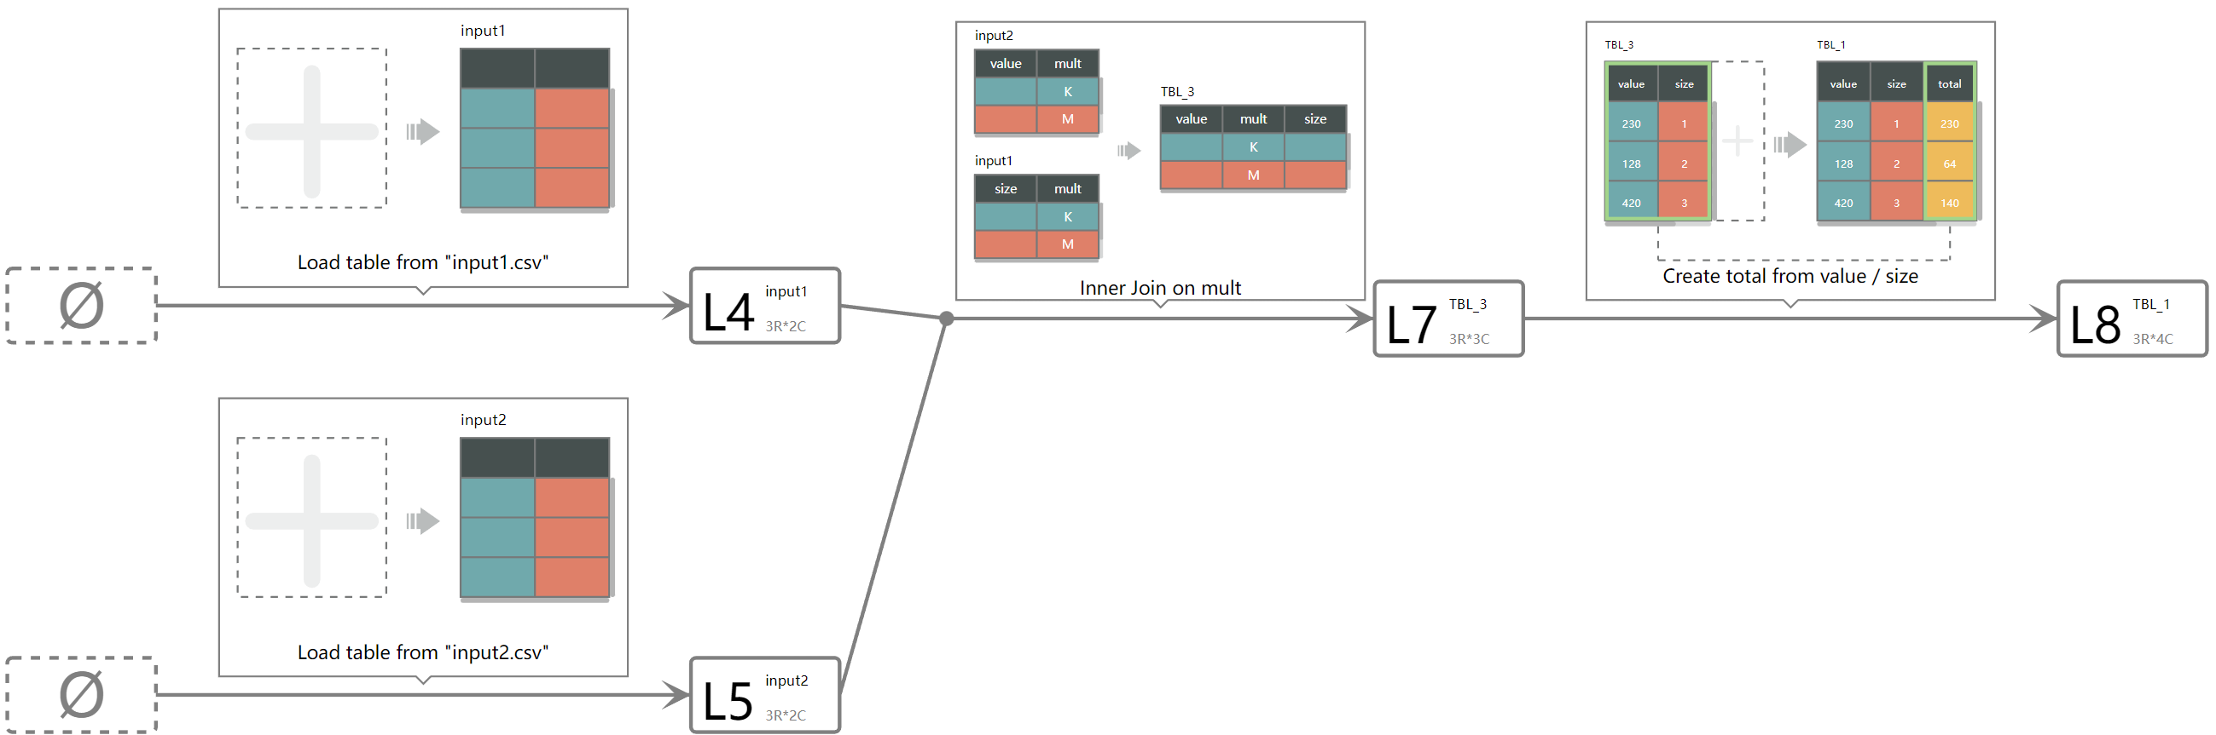
SOMNUS
Program Adaptor
Visualization Generator
Notes:
Finally, we depict glyphs <click> aside from each edge to present the detailed semantics of data transformations, thus <click> gaining the final provenance graph.

Slide 32
User Study
Q1: Does the glyph design improve user efficiency in comprehending the semantics of data transformation?
5 function understanding tasks (Func)
Q2: Does the provenance graph facilitate the understanding of data dependencies?
5 script understanding tasks (Script)
Notes:
To assess the effectiveness of our visualization design, we conducted a user study centered on two high-level questions.
We designed <click> five function understanding tasks and five script understanding tasks to answer the two questions, respectively.

Slide 33
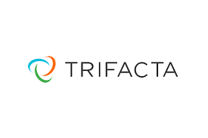
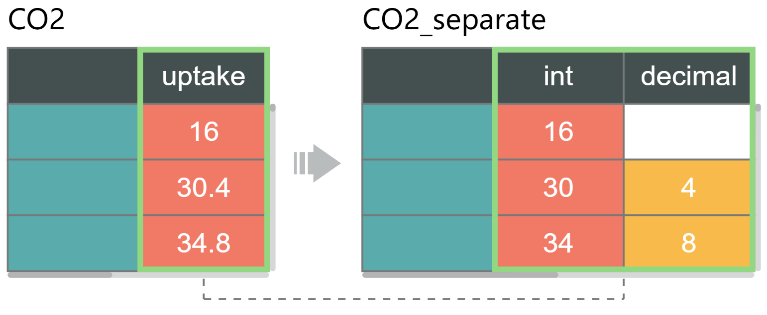
User Study
Techniques:
Code:
Text: Split uptake on delimiters matching '.' into "int" and "decimal" columns
Visualization:
Notes:
We compared our visualization design with textual descriptions derived from Trifacta.

Slide 34
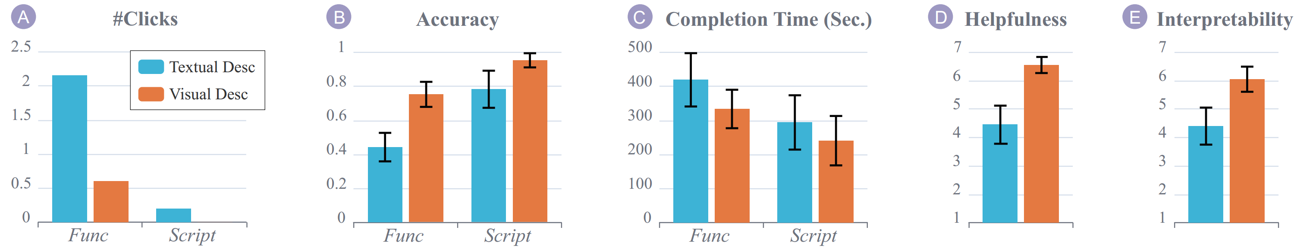
User Study
Participants:
20 subjects (4 females, 16 males, age: 22-35)
Results:
Notes:
We recruited 20 subjects to conduct the user study.
<click> The results show that participants achieved better accuracy with less time using SOMNUS, and preferred it over textual description.

Slide 35

Example Applications
Double-checking:
help data scientists validate the procedure of data transformation
MORPHEUS Revisited:
reveal intermediate data transformations given source and target tables
Source
Target
Y. Feng, R. Martins, J. Van Geffen, I. Dillig, and S. Chaudhuri. Component-based synthesis of table consolidation and transformation tasks from examples. ACM SIGPLAN Notices, 2017.
Notes:
Besides, we implement two prototypes to demonstrate how SOMNUS can be applied to different usage scenarios.
Here we introduce the two prototypes with a video.

Slide 36
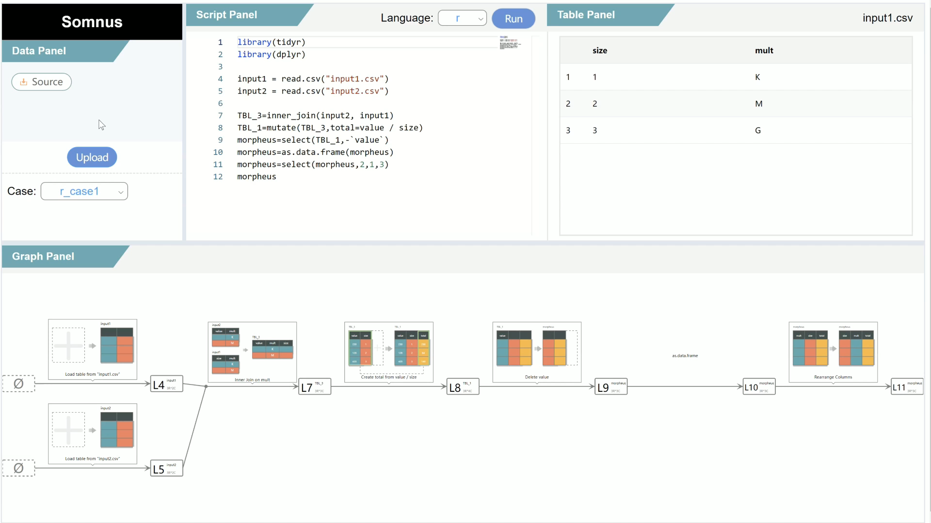
Notes:
SOMNUS is implemented as a web-based system, which has four panels. <5.1> The Data Panel allows users to upload their input tables.<10.2> After selecting a programming language and <14.1> copy-pasting a piece of data wrangling code to the Script Panel, <18.7> users can click on the “Run” button to gain table provenance displayed in the Graph Panel. <27.3> Users can zoom and pan the graph to switch between an overview and a detailed view of individual transformations. Besides, users <37> can click on a node, and the Table Panel displays the detailed table. Similarly, <44> when clicking on an edge, its function in the Script Panel is located and highlighted, <50.6> and vice versa. <53.3> Users can modify the code and <58.7> Run it again to see how the code affects the transformation results.
We also apply SOMNUS to explain scripts generated by MORPHEUS. Assume Devin has two original tables and one target table at hand. <1’15> He first uploads those tables to the system to understand how to transform the original tables to the target table.<1’21.8> After clicking on the "Upload and Run" button, a piece of code is shown in the Script Panel, and a provenance graph is displayed in the Graph Panel.Devin sees seven edges from the provenance graph, indicating that the entire process takes seven data transformations. <1’40>

Slide 37


Conclusion
Contributions
a design space consisting of two dimensions that guide the design of a collection of 23 glyphs.
a pipeline, SOMNUS, that visualizes the creation and evolution of data tables across a series of transformations.
a controlled study that evaluates how users perform with visualization and text using comparison tasks.
two example applications that showcase how SOMNUS can benefit different usage scenarios.
Future Work
enhance SOMNUS by supporting a large number of functions and parameters.
explore how to visualize conditional statements and loops in the provenance graph.
Notes:
In summary, the contributions of the work include a design space of glyphs for depicting data transformations, a pipeline SOMNUS for visualizing data wrangling scripts, a controlled study and two example applications.
In the future, we plan to enhance SOMNUS by supporting more various functions and explore how to visualize conditional statements and loops.

Slide 38

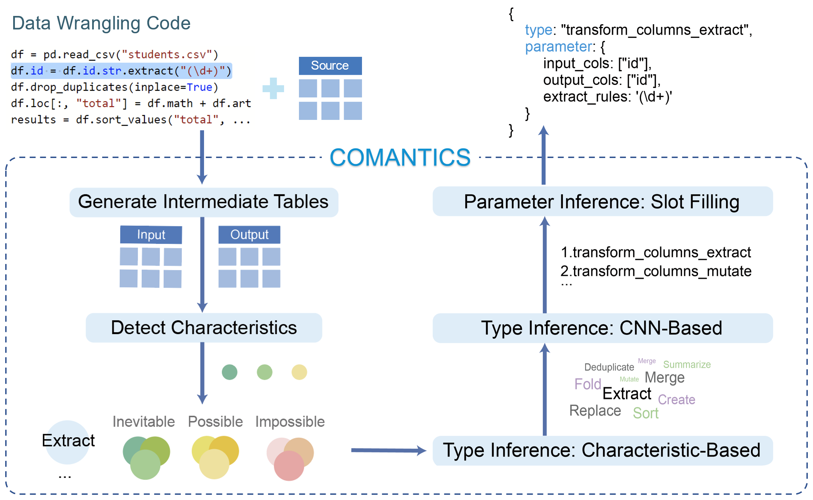
Visualizing the Scripts of Data Wrangling with SOMNUS
Kai Xiong, Siwei Fu, Guoming Ding, Zhongsu Luo, Rong Yu, Wei Chen, Hujun Bao, Yingcai Wu
SOMNUS
Thank You!
COMANTICS
IEEE TVCG 2022
IEEE VIS 2022
E-mail: kaixiong@zju.edu.cn
Notes:
That concludes my presentation. I'm ready to take questions, thank you.

